Slide 1

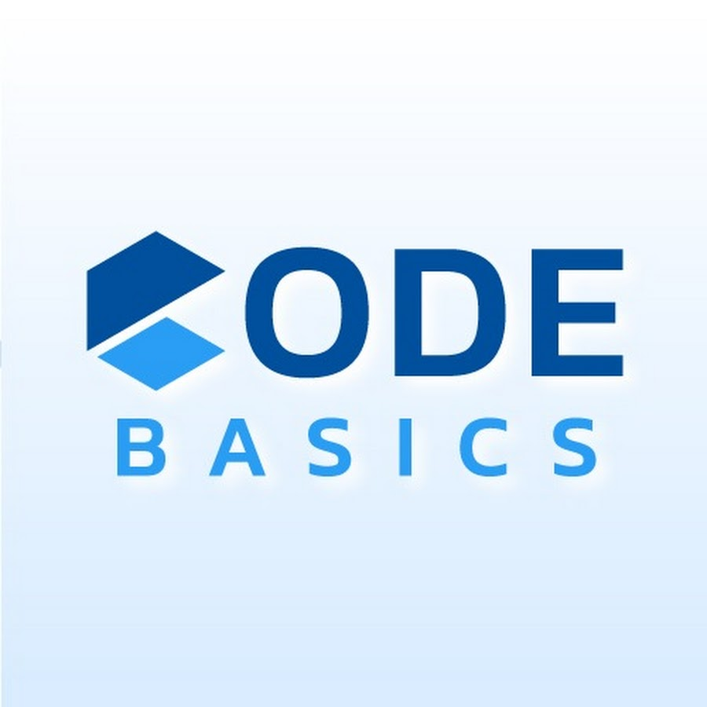



Slide 2



Strategic Insights to Atliq Motors an Automotive company on Electric vehicles launch in India
by Ansh Mattoo

Slide 3

Agenda:→
1.Problem Statement
2.Goal
3.Dashboard ShowCase
4.Insights on the basis of Dashboard.
5.Top 3 Recommendations.

Slide 4


Problem Statement:→
AtliQ Motors is an automotive giant from the USA specializing in electric vehicles (EV). In the last 5 years, their market share rose to 25% in electric and hybrid vehicles segment in North America. As a part of their expansion plans, they wanted to launch their bestselling models in India where their market share is less than 2%. Bruce Haryali, the chief of AtliQ Motors India wanted to do a detailed market study of existing EV/Hybrid market in India before proceeding further. Bruce gave this task to the data analytics team of AtliQ motors and Peter Pandey is the data analyst working in this team.

Slide 5

Goal:→
My goal is to analyze the Indian EV/Hybrid market to guide AtliQ Motors' expansion strategy.The idea is to deliver a concise, data-driven presentation that provides actionable insights to Bruce Haryali who is the chief of AtliQ Motors India on how AtliQ Motors can successfully increase its market share in India.

Slide 6

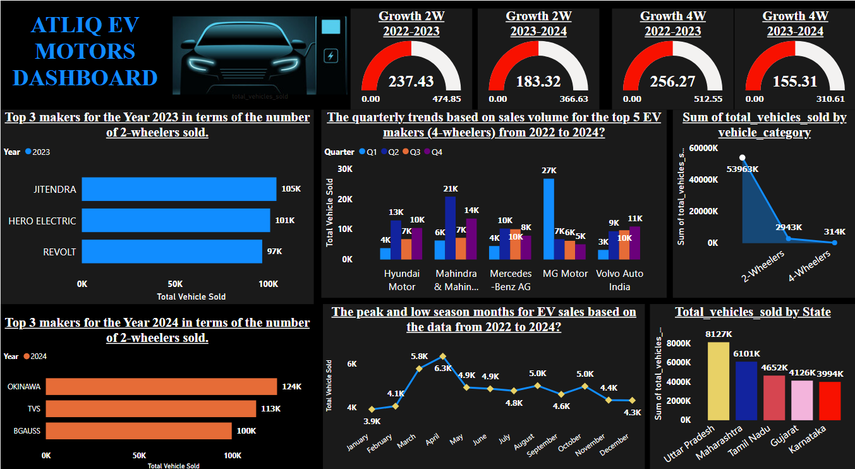

Slide 7
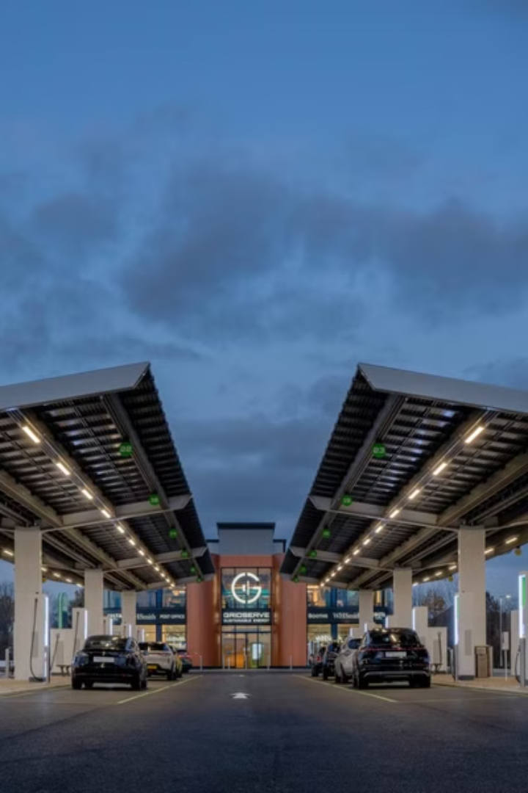
Electric Vehicle Market Trends: An Overview
The electric vehicle (EV) market is experiencing rapid growth in India, with various factors driving consumer adoption. Government incentives, environmental awareness, and the desire for cost savings are key motivators for choosing electric vehicles.

Slide 8

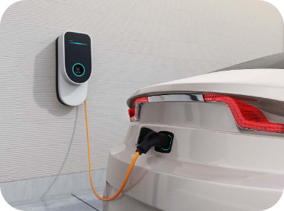
Primary Reasons for Choosing Electric 4-Wheelers
1
Cost Savings
2
Environmental Concerns
3
Government Incentives
Electric vehicles offer significant cost savings compared to traditional gasoline-powered vehicles. Electricity is cheaper than gasoline, resulting in lower running costs and long-term fuel savings.
Consumers are increasingly aware of climate change and environmental pollution. Electric vehicles emit zero tailpipe emissions, making them a more sustainable choice.
Governments in India offer various incentives and subsidies to encourage EV adoption. These incentives include tax benefits, rebates, and subsidies that reduce the upfront cost of purchasing an EV.

Slide 9
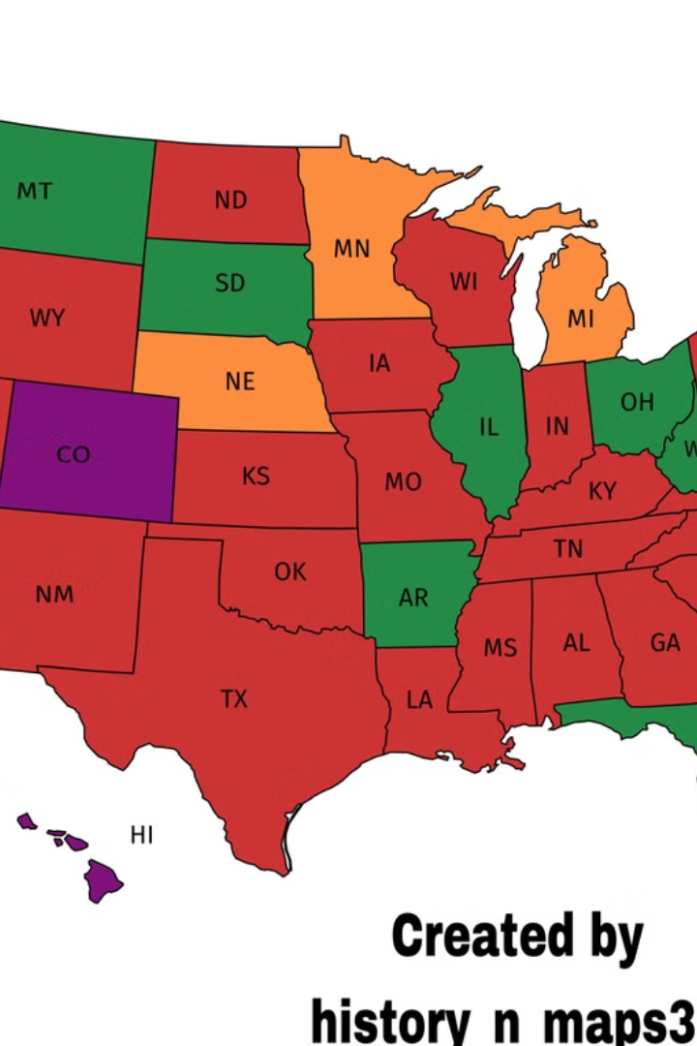
Impact of Government Incentives on Adoption Rates
State
Incentives
Adoption Rate
Maharashtra
High subsidies for electric two-wheelers
Increased adoption of electric two-wheelers
Gujarat
Substantial subsidies for electric two-wheelers
Higher adoption of electric two-wheelers
Delhi
Significant incentives for electric cars
Higher adoption rates for electric cars
Tamil Nadu
Substantial incentives for electric cars
Higher adoption rates for electric cars

Slide 10
Charging Station Infrastructure and EV Adoption Rates
Top 5 States
Correlation
Maharashtra
A strong correlation exists between the availability of charging stations and EV sales. Increased charging infrastructure builds consumer confidence and reduces range anxiety, leading to higher adoption rates.
Tamil Nadu
Karnataka
Gujarat
Delhi

Slide 11


Brand Ambassador for AtliQ Motors
Bollywood Celebrity
A popular and environmentally conscious Bollywood celebrity, like SHARUKH KHAN, could be an effective brand ambassador due to his cross-generational appeal.
Sportsperson
A popular sportsperson, like Virat Kohli, could target a younger demographic and emphasize the eco-friendly aspects of EVs.

Slide 12



Ideal States for Manufacturing Unit
Tamil Nadu
Maharashtra
Gujarat
Tamil Nadu offers a strong auto manufacturing ecosystem, favorable policies, and skilled labor, making it an attractive location for an EV manufacturing unit.
Maharashtra boasts high industrial output, excellent infrastructure, and good governance, creating a favorable environment for manufacturing operations.
Gujarat provides substantial subsidies, good infrastructure, and a business-friendly environment, making it an ideal state for setting up a manufacturing unit.

Slide 13

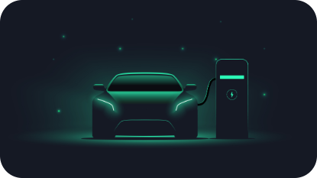



Top 3 Recommendations for AtliQ Motors
Focus on Infrastructure
AtliQ Motors should collaborate with government agencies and private players to expand charging infrastructure across India, providing greater convenience and accessibility for EV owners.
Incentivize Early Adopters
AtliQ Motors should offer attractive pricing and financing options to incentivize early adoption of electric vehicles. This can include subsidies, discounts, and financing schemes to make EVs more affordable for consumers.
Leverage Technology and Innovation
AtliQ Motors should invest heavily in R&D for battery technology and vehicle design. This will lead to improved range, reduced costs, and more competitive EVs in the market.

Slide 14
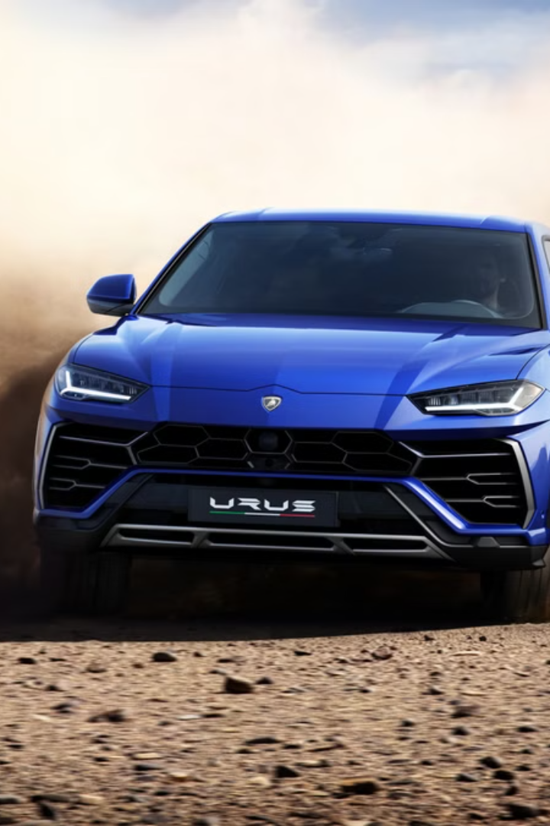
Future of Electric Vehicles in India
The future of electric vehicles in India is bright. With government support, increased awareness, and advancements in technology, EV adoption rates are expected to grow significantly in the coming years. AtliQ Motors has a strong opportunity to capitalize on this growth by focusing on infrastructure development, innovative technologies, and strategic marketing initiatives.

